Slide 1
Data Structures and algorithms HEAP

Slide 2
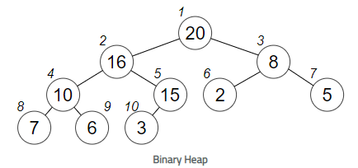
HEAP – DATA STRUCTURE
Heap data structure is a complete binary tree that satisfies the heap property. It is also called as a binary heap.
A complete binary tree is a special binary tree in which
every level, except possibly the last, is filled
all the nodes are as far left as possible

Slide 3
HEAP – DATA STRUCTURE
The heap property
The heap property says that is the value of Parent is either greater than or equal to (in a max heap) or less than or equal to (in a min heap) the value of the Child.
A heap is described in memory using linear arrays in a sequential manner.

Slide 4
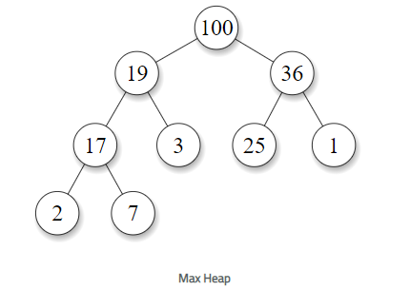
HEAP – DATA STRUCTURE
Max Heap
In a max heap, the key present at the root is the largest in the heap and all the values below this are less than this value.

Slide 5
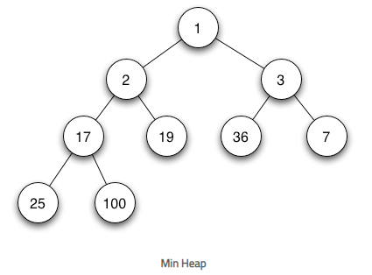
HEAP – DATA STRUCTURE
Min Heap
In a min heap, the key present at the root is the smallest in the heap and all the values below this are greater than this value.

Slide 6

HEAP – DATA STRUCTURE
Heap Operations
Some of the important operations performed on a heap are described below along with their algorithms.
Heapify
Heapify is the process of creating a heap data structure from a binary tree. It is used to create a Min-Heap or a Max-Heap.
Let the input array be

Slide 7
HEAP – DATA STRUCTURE
Heap Operations
Some of the important operations performed on a heap are described below along with their algorithms.
Heapify
Heapify is the process of creating a heap data structure from a binary tree. It is used to create a Min-Heap or a Max-Heap.
Let the input array be

Slide 8
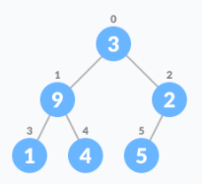
HEAP – DATA STRUCTURE
Create a complete binary tree from the array

Slide 9
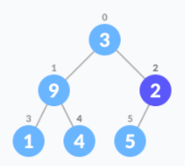
HEAP – DATA STRUCTURE
Start from the first index of non-leaf node whose index is given by n/2 - 1

Slide 10
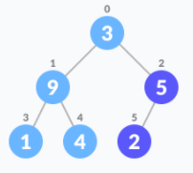
HEAP – DATA STRUCTURE
Set current element i as largest.
The index of left child is given by 2i + 1 and the right child is given by 2i + 2.
If leftChild is greater than currentElement (i.e. element at ith index), set leftChildIndex as largest.
If rightChild is greater than element in largest, set rightChildIndex as largest.
Swap largest with currentElement
Repeat steps 3-7 until the subtrees are also heapified.

Slide 11
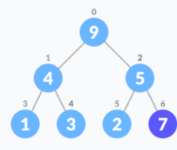
HEAP – DATA STRUCTURE
Insert Element into Heap
Insert the new element at the end of the tree.

Slide 12
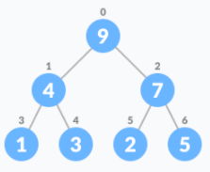
HEAP – DATA STRUCTURE
Heapify the tree.

Slide 13
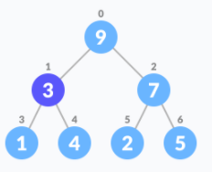
HEAP – DATA STRUCTURE
Delete Element from Heap
Select the element to be deleted.

Slide 14
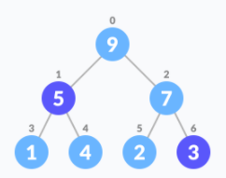
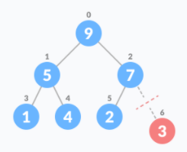
HEAP – DATA STRUCTURE
Swap it with the last element.
Remove the last element.

Slide 15
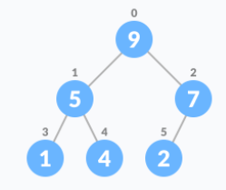
HEAP – DATA STRUCTURE
Heapify the tree.
For Min Heap, above algorithm is modified so that both childNodes are greater smaller than currentNode.

Slide 16
HEAP – DATA STRUCTURE
Peek (Find max/min)
Peek operation returns the maximum element from Max Heap or minimum element from Min Heap without deleting the node.
For both Max heap and Min Heap
return rootNode
Extract-Max/Min
Extract-Max returns the node with maximum value after removing it from a Max Heap whereas Extract-Min returns the node with minimum after removing it from Min Heap.

Slide 17
HEAP – DATA STRUCTURE
Heap Data Structure Applications
Heap is used while implementing a priority queue.
Dijkstra’s Algorithm
Heap Sort

